Slide 1
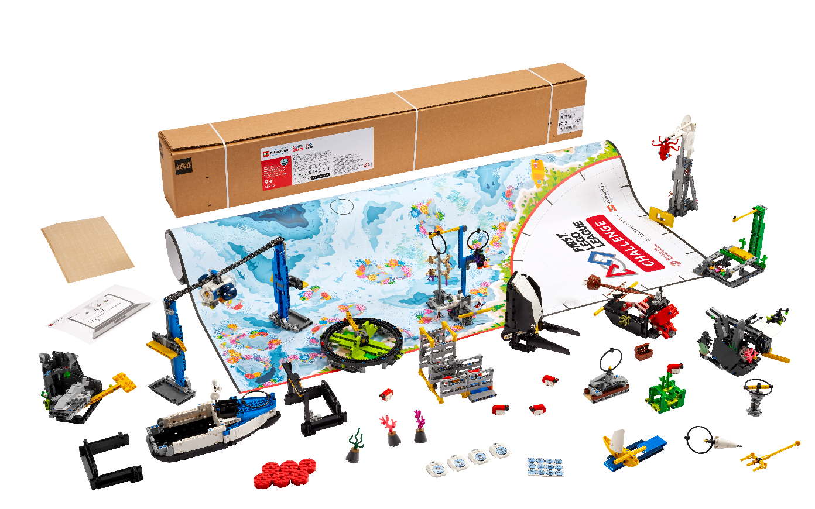


Session 2
Training Camp 1
Notes:
Session 2 Tips =
Example prompts for goal setting are provided in the Engineering Notebook.
Remind the team to back up saved program files.
After a program is downloaded onto the controller, it cannot be transferred back to be opened and edited.
Have the team practice their new skills by trying to drive the robot to a model and then returning to home.
Robot Game Connection: Have the team code the robot to push an object and deliver it to a target area on the mat.

Slide 2
Session Overview
Outcomes
Build a driving base and code it to move forward, move backward, and turn.
Explore careers related to the theme and the Project Sparks.
Notes:
Session Outcomes
Build a driving base and code it to move forward, move backward, and turn.
Explore careers related to the theme and the Project Sparks.
Session 2 Tips
Teams will explore the six Core Values throughout their season.
The Tutorial Activities are optional but recommended if your team has minimal coding experience.
After a program is downloaded onto the controller, it cannot be transferred back to be opened and edited.
Have the team practice their new skills by trying to drive the robot to a model and then returning to home.
Check out the Career Connections page in the Engineering Notebook. The team should be working toward selecting a problem for their project over the next few sessions.

Slide 3
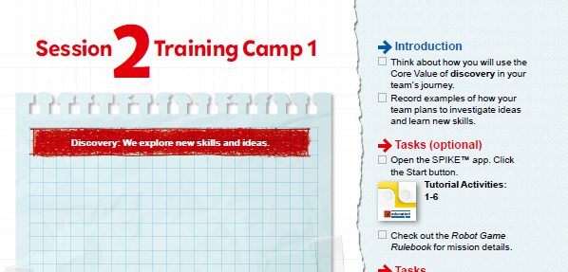
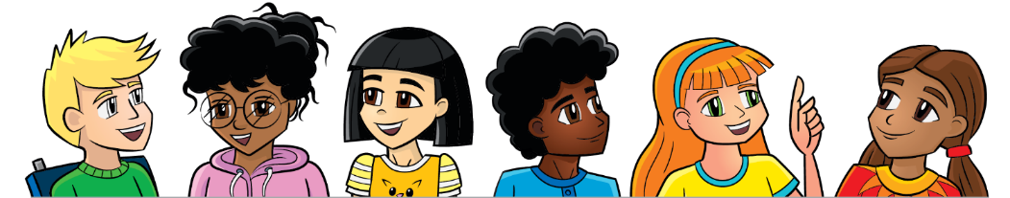
Introduction
Think about how you will use the Core Value of discovery in your team’s journey.
Record examples of how your team plans to investigate ideas and learn new skills.
Notes:
Session Outcomes
Build a driving base and code it to move forward, move backward, and turn.
Explore careers related to the theme and the Project Sparks.
Session 2 Tips
Teams will explore the six Core Values throughout their season.
The Tutorial Activities are optional but recommended if your team has minimal coding experience.
After a program is downloaded onto the controller, it cannot be transferred back to be opened and edited.
Have the team practice their new skills by trying to drive the robot to a model and then returning to home.
Check out the Career Connections page in the Engineering Notebook. The team should be working toward selecting a problem for their project over the next few sessions.

Slide 4
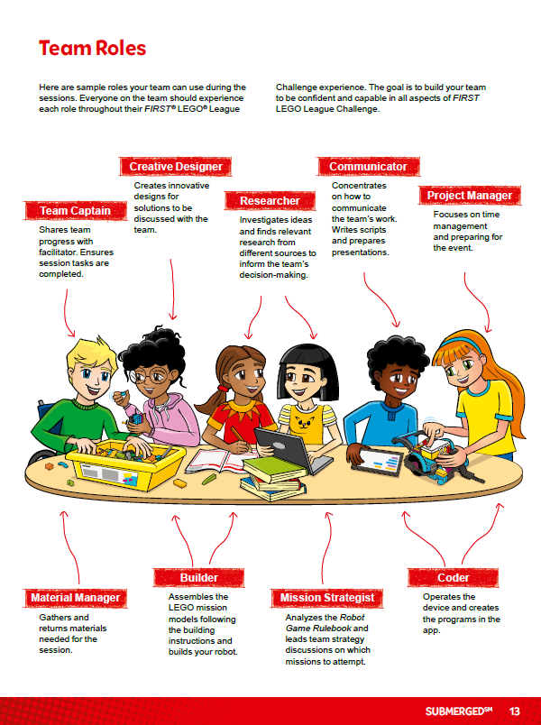
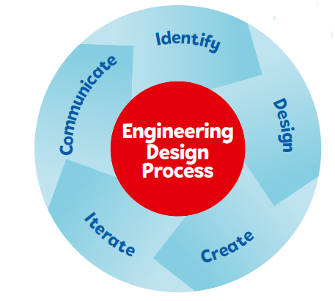
Introduction
In this session, use the engineering design process and try out using the team roles listed on page 13.
Notes:
Session Outcomes
Build a driving base and code it to move forward, move backward, and turn.
Explore careers related to the theme and the Project Sparks.
Session 2 Tips
Teams will explore the six Core Values throughout their season.
The Tutorial Activities are optional but recommended if your team has minimal coding experience.
After a program is downloaded onto the controller, it cannot be transferred back to be opened and edited.
Have the team practice their new skills by trying to drive the robot to a model and then returning to home.
Check out the Career Connections page in the Engineering Notebook. The team should be working toward selecting a problem for their project over the next few sessions.

Slide 5
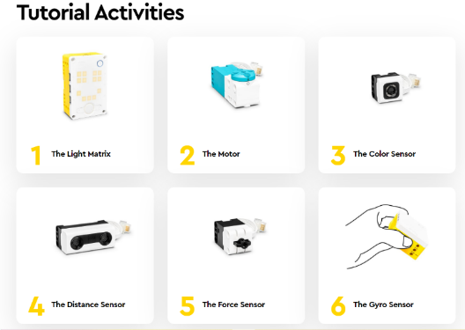

Robot Lesson 1 (optional)
Open the SPIKE™ Prime app. Click the Start button.
Check out the Robot Game Rulebook for mission details.
Notes:
These activities are designed to familiarize your team with the SPIKE hardware and software. If your team is familiar, you may proceed to the next lesson.

Slide 6
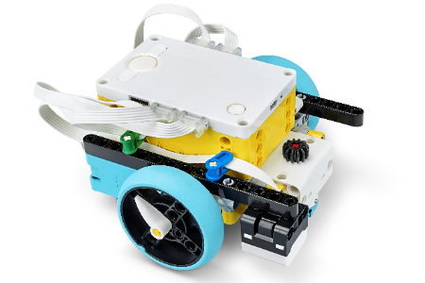

Robot Lesson 2
Open the SPIKE™ Prime app. Find your lesson.
Determine what coding and building skills you can apply in the robot game.
Try it out! Which missions look like the most fun?
See if you can use the skills you learned to drive your robot to one of the mission models.
Notes:
Team Tasks (100-120 minutes) - Training Camp 1: Driving Around – https://education.lego.com/en-us/lessons/prime-competition-ready/training-camp-1-driving-around#lesson-plan
URL for SPIKE on-line: https://spike.legoeducation.com (remember to use a Chrome browser)
Session Outcomes
Build a driving base and code it to move forward, move backward, and turn.
Explore careers related to the theme and the Project Sparks.
Session 2 Tips
Teams will explore the six Core Values throughout their season.
The Tutorial Activities are optional but recommended if your team has minimal coding experience.
After a program is downloaded onto the controller, it cannot be transferred back to be opened and edited.
Have the team practice their new skills by trying to drive the robot to a model and then returning to home.
Check out the Career Connections page in the Engineering Notebook. The team should be working toward selecting a problem for their project over the next few sessions.

Slide 7
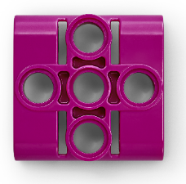
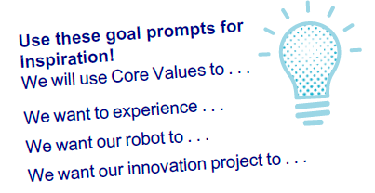
Reflection Questions
Which of the careers in the Project Sparks does your team want to explore more?
How can you aim your robot toward a model?
How did you use the engineering design process and team roles in this session?
Notes:
Session Outcomes
Build a driving base and code it to move forward, move backward, and turn.
Explore careers related to the theme and the Project Sparks.
Session 2 Tips
Teams will explore the six Core Values throughout their season.
The Tutorial Activities are optional but recommended if your team has minimal coding experience.
After a program is downloaded onto the controller, it cannot be transferred back to be opened and edited.
Have the team practice their new skills by trying to drive the robot to a model and then returning to home.
Check out the Career Connections page in the Engineering Notebook. The team should be working toward selecting a problem for their project over the next few sessions.

Slide 8
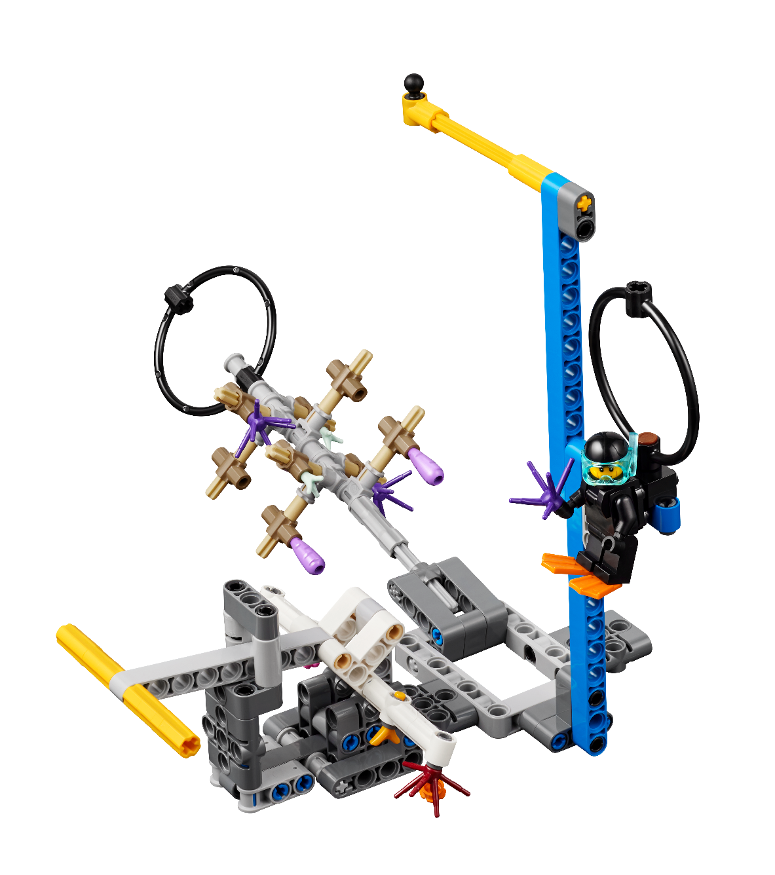
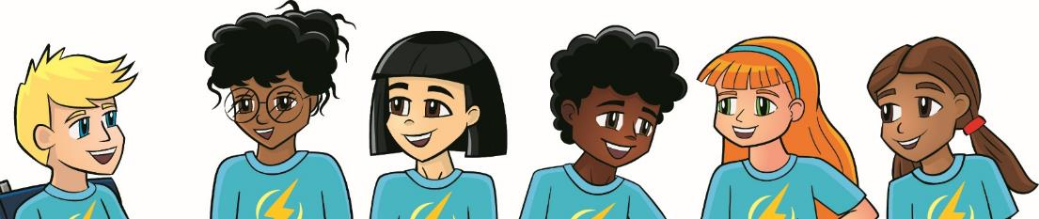
Share
Get together at the mat.
Share the robot skills you learned.
Chat about the reflection questions.
Clean up your space.
Notes:
Session Outcomes
Build a driving base and code it to move forward, move backward, and turn.
Explore careers related to the theme and the Project Sparks.
Session 2 Tips
Teams will explore the six Core Values throughout their season.
The Tutorial Activities are optional but recommended if your team has minimal coding experience.
After a program is downloaded onto the controller, it cannot be transferred back to be opened and edited.
Have the team practice their new skills by trying to drive the robot to a model and then returning to home.
Check out the Career Connections page in the Engineering Notebook. The team should be working toward selecting a problem for their project over the next few sessions.

Slide 9
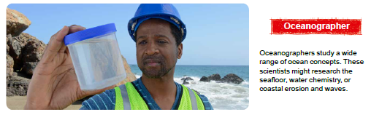
Career Connections

Slide 10

Multimedia Resources
You may wish to embed a relevant, age-appropriate video for your students here.
Notes:
Choose a relevant, age-appropriate video for your students.

Slide 11

Clean Up
Notes:
Allow time for cleanup and place any unfinished models and their pieces in a sealed plastic bag.
Clean Up Pointers
You may wish to play a video or song during clean up time Link on
GoNoodle: https://family.gonoodle.com/activities/clean-up
Link on YouTube Kids: https://www.youtubekids.com/watch?v=ZJFk87ZsHn0
Link on Youtube: https://youtu.be/ZJFk87ZsHn0

Slide 12


LEGO, the LEGO logo, the SPIKE logo, MINDSTORMS and the MINDSTORMS logo are trademarks of the/sont des marques de commerce du/son marcas registradas de LEGO Group. ©2024 The LEGO Group. All rights reserved/Tous droits réservés/Todos los derechos reservados. FIRST ®, the FIRST ® logo, Coopertition ®, Gracious Professionalism®, and FIRST® DIVESM are trademarks of For Inspiration and Recognition of Science and Technology (FIRST). LEGO® is a registered trademark of the LEGO Group. FIRST® LEGO® League and SUBMERGEDSM are jointly held trademarks of FIRST and the LEGO Group. All other trademarks are the property of their respective owners. ©2024 FIRST and the LEGO Group. All rights reserved.

